Slide 1
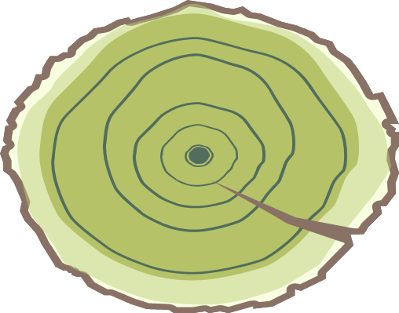
​
Reading out of the rings
We are able to extract many information out of tree rings.
Please look at the sketches of the stem disks carefully and find out the solution.
P: I‘m 9 years old. I got damaged from insects when I was 2 years old.
T: I‘m 7 years old. I had some years of good growth until I was 6 years old. The last year wasn‘t so good.
R: I‘m 6 years old. I experienced a forest fire 2 years ago.
M: I‘m 6 years old. It has rained a lot every year of my life.
I’m 7 years old. I was injured by insects when I was 3 years old. R: right
A: wrong
1
2
A: I’m 9 years old. I was injured by insects when I was 2 years old.
I: I’m 5 years old. I had some years of good growth until I was 4 years old. The last year wasn't so good.
S: I’m 6 years old. I experienced a forest fire 2 years ago.
E: I ‘m 6 years old. It has rained a lot every year of my life.
I’m 6 years old. I experienced a forest fire 2 years ago.
E: right
L: wrong
3
4

